Slide 1
RNA-Seq Transcriptome Profiling Identifies CRISPLD2 as a Glucocorticoid Responsive Gene that Modulates Cytokine Function in Airway Smooth Muscle Cells
BCB/EEOB546 Final Project
Veeraya Bamrung, Emma Tran

Slide 2
OUTLINE
1.
Background on the biological question being investigated
2.
An overview of the group's documentation
3.
A description of the workflow carried out by the group
4.
Presentation of results including comparison to results

Slide 3
OUTLINE
1.
Background on the biological question being investigated
2.
An overview of the group's documentation
3.
A description of the workflow carried out by the group
4.
Presentation of results including comparison to results

Slide 4
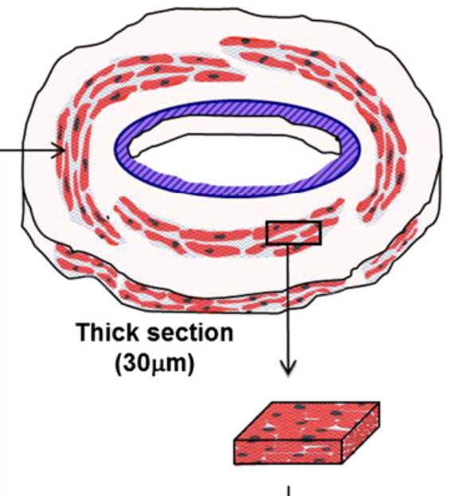
Background: What is the question?
The core question is “Which genes change in airway smooth muscle cells after dexamethasone treatment?”
The paper examines how dexamethasone changes gene expression in human airway smooth muscle (ASM) cells
This matters because glucocorticoids are major asthma therapies, but their anti-inflammatory mechanism in ASM remains unclear
Using bulk RNA-seq, extracted RNA of airway smooth muscle cells from 4 donors were used and cell sample was sequenced the combined RNA
The study identified 316 differentially expressed genes after dexamethasone treatment
Notes:
The biological question is straightforward: when ASM cells are exposed to dexamethasone, which genes change, and what do those changes tell us about how glucocorticoids work in asthma?
ASM is important because it contributes to airway narrowing and airway hyperresponsiveness, so understanding drug effects in this tissue has direct relevance to asthma treatment.
The paper’s RNA-seq analysis found 316 significant expression changes, which gave the authors a broad transcriptomic view of the glucocorticoid response.
CRISPLD2 became the main follow-up target because it was differentially expressed and also looked biologically relevant for inflammatory regulation.
The paper then showed that CRISPLD2 increased after dexamethasone treatment and may help modulate inflammatory cytokine responses in ASM

Slide 5
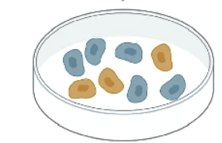
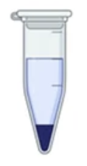

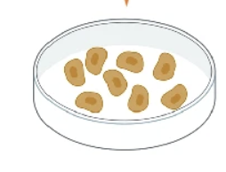
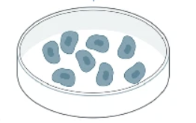
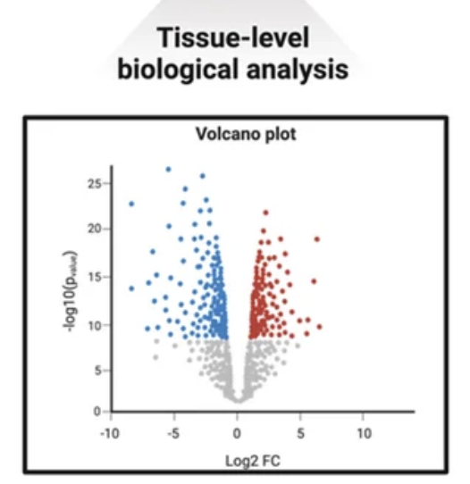
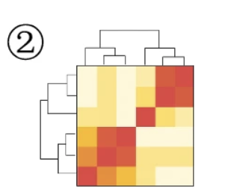
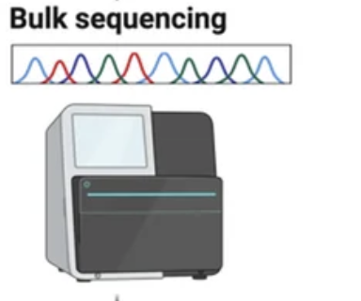
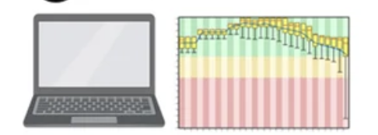
Background: Bulk RNA-seq to gene identification
Airway Smooth Muscle Cells
Treatment: Dexamethasone
(1 µM;18 hrs)
cDNA library synthesis
4 donor cell lines
RNA extraction
Non-treatment: Control
Gene expression profile
DE analysis
Quality control
Reference
cell lines: https://www.nature.com/articles/s41467-024-48282-5/figures/1
SM cells: https://www.semanticscholar.org/paper/Estimating-airway-smooth-muscle-cell-volume-and-in-Jones-Elliot/7b8acdd93cefe3d2c108f1a76a8085a4b09c98eb
Notes:
Our pipeline will be able to find a gene correlated with the treatment and the study further experimentally validate those
Bulk RNA-seq is a method used to measure gene expression across a whole sample of cells. In this slide, the sample is airway smooth muscle cells. Instead of measuring each single cell separately, all RNA from the cell population is pooled together, converted into a cDNA library, sequenced, and analyzed to estimate which genes are more or less active. The workflow begins with airway smooth muscle cells collected from four donor cell lines. Each donor’s cells were divided into two conditions: a dexamethasone-treated condition and an untreated control condition. The treatment condition received 1 micromolar dexamethasone for 18 hours, while the control condition was left untreated or treated with vehicle control.
After treatment, total RNA was extracted from the cells. This RNA represents the genes that were actively being expressed in the airway smooth muscle cells under each condition. the RNA was converted into complementary DNA, or cDNA. These cDNA fragments were then prepared into sequencing libraries by adding adapters and barcodes.
The libraries were sequenced using bulk RNA sequencing. This means that the RNA signal came from the whole population of cells in each sample, not from individual cells.
After sequencing, the raw reads went through quality control. The authors checked whether the reads were successfully sequenced and whether the data were reliable enough for downstream analysis. They used tools such as FastQC and trimmed the first 12 bases because the reads showed sequence bias at the beginning. The cleaned reads were then aligned to the human reference genome using TopHat.
Finally, differential expression analysis was used to compare dexamethasone-treated cells with untreated control cells. This analysis identified genes whose expression levels changed after dexamethasone treatment.

Slide 6
Background
Our work replicates only
the differential expression analysis in R
volcano plot portion in R (Figure 1)
Top (Q-value <6E-10) differentially expressed genes [Table 1]
Workflow of differential expression analysis in a separated documentation [more details]
The R pipeline covers:
Obtain GEO processed files
Read the datasets
Create variables to match column information
Figure 1A: Volcano plot replication
Table 1 replication
Actual paper
Detailed workflow
Loading the prepared dataset
Setting up the model ~ cell + dex,
PCA and sample-distance visualization,
Differential expression testing with DESeq2
Significance filtering
Annotation of the data
Notes:
Our pipeline will be able to find a gene correlated with the treatment and the study further experimentally validate those

Slide 7
OUTLINE
1.
Background on the biological question being investigated
2.
An overview of the group's documentation
3.
A description of the workflow carried out by the group
4.
Presentation of results including comparison to results

Slide 8
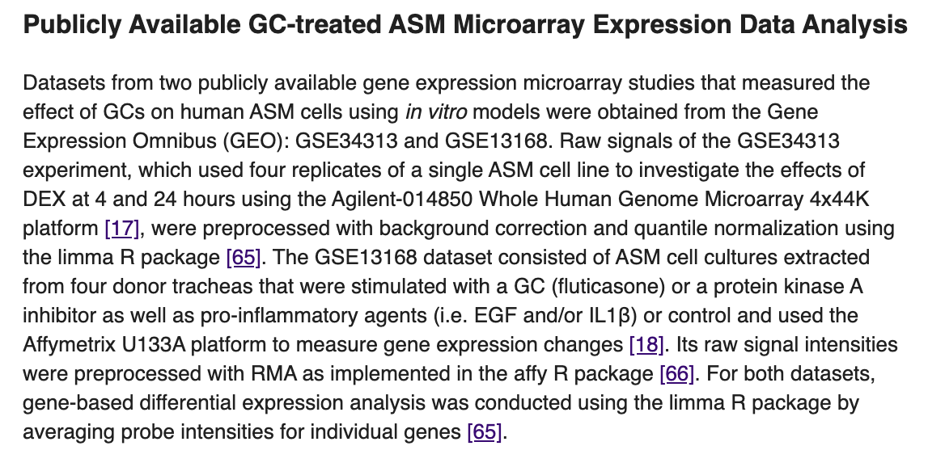
Journal Documentation

Slide 9
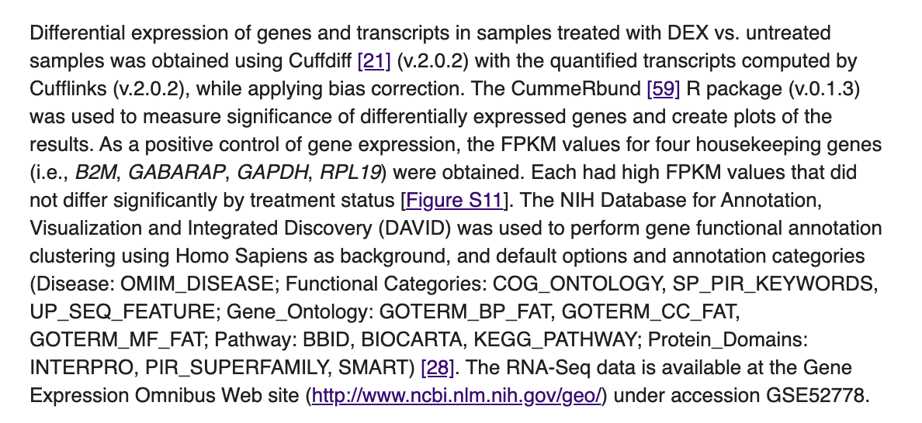
Journal Documentation

Slide 10
Group's documentation
1. Types of Data, Samples, Software, and Other Materials
This project will generate 5 data and research materials
Plots and figures – PNG.
Summary tables – CSV.
Software and code - .R
Author-date - .md
PowerPoint presentation - .pptx
All will be archived in GitHub and workflow in shared google document [for short term storage]
2. Standards for Data and Metadata Format and Content
Metadata will be recorded in project-level README files
Policies for Access and Sharing
This project does involve human subjects, however no confidential information was shared
Data will be shared after the presentation

Slide 11
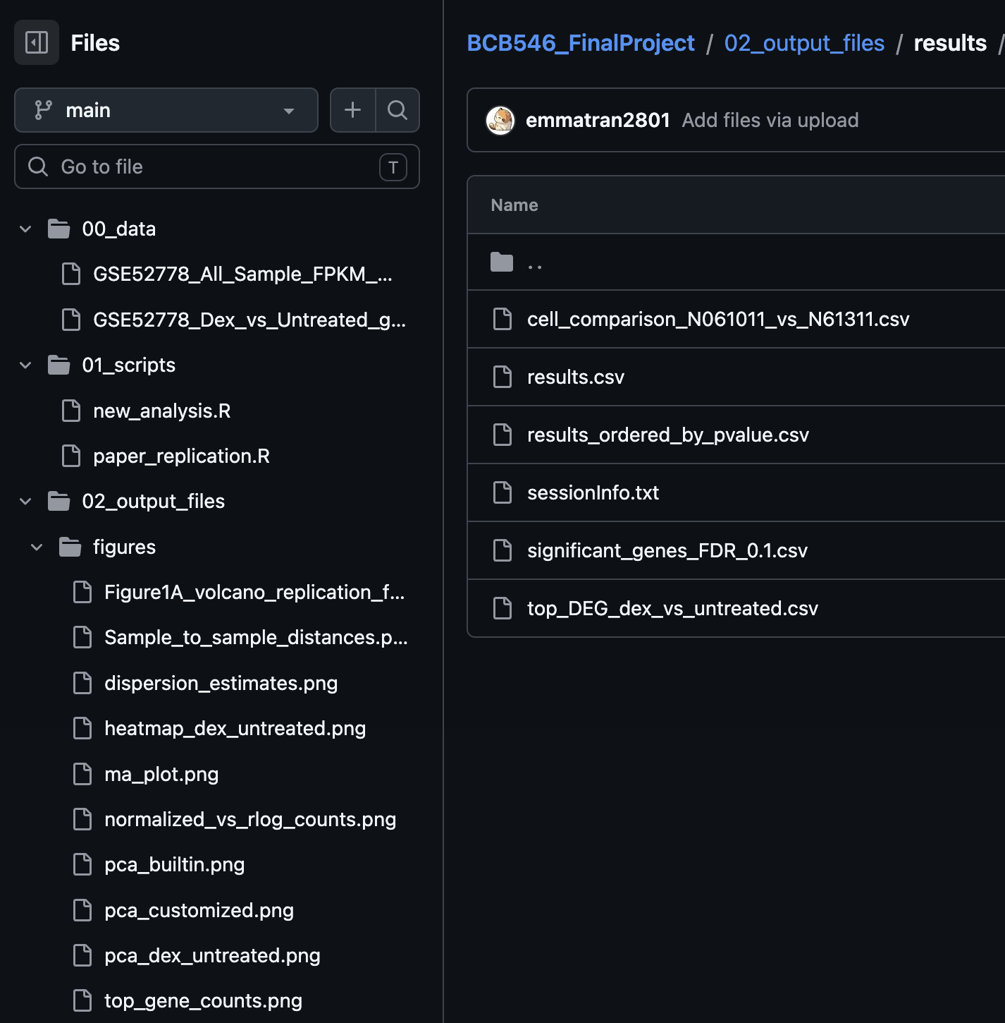

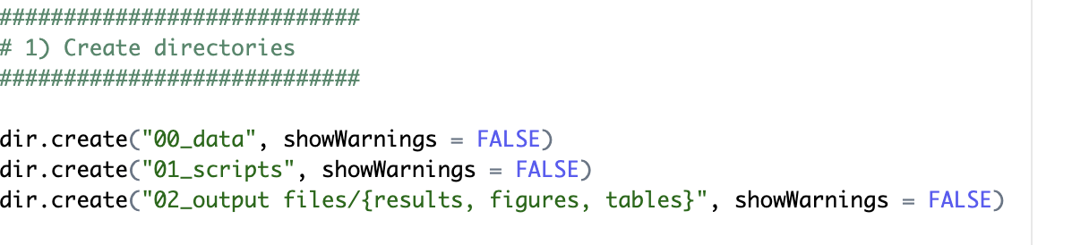
Group's documentation

Slide 12
OUTLINE
1.
Background on the biological question being investigated
2.
An overview of the group's documentation
3.
A description of the workflow carried out by the group
4.
Presentation of results including comparison to results

Slide 13
General Workflow
RNA-seq preprocessing and quality control
2. Read alignment and expression quantification
3. Differential expression and functional enrichment
Checks whether the sequencing data are usable before
Maps reads to the reference genome/transcripts and computes expression levels as FPKM for genes and transcripts
Identifies genes that change with dexamethasone treatment
6. Regulatory annotation and biological interpretation
5.Public microarray re-analysis for replication/support
4. Pharmacogenetic GWAS comparison
Interpretation step to see whether the RNA-seq signal overlaps plausible regulatory binding regions near CRISPLD2
Checks whether the RNA-seq finding, especially for CRISPLD2, is also supported by older microarray studies of glucocorticoid-treated ASM cells.
Tests whether genes highlighted by RNA-seq also sit near variants associated with asthma drug-response phenotypes
Notes:
FPKM (Fragments Per Kilobase of transcript per Million mapped reads) is an RNA-seq normalization method for quantifying gene expression by accounting for sequencing depth and gene length.
Microarray studies use high-throughput technology to analyze thousands of genes, DNA sequences, or RNA transcripts simultaneously by binding them to a solid surface (chip). These studies measure gene expression (RNA) or detect genetic variations like copy number variants (CNVs).
This slide shows the overall workflow used in the paper by Himes et al. The study focused on identifying genes in primary human airway smooth muscle cells that respond to glucocorticoid treatment.
The first step was RNA-seq preprocessing and quality control. This is to check whether the sequencing data were usable by using quality-control tools such as FastQC
The second step was read alignment and expression quantification. After trimming, reads were aligned to the hg19 reference genome using TopHat, and expression levels were quantified with Cufflinks. Differential expression between dexamethasone-treated and untreated samples was then tested using Cuffdiff, with CummeRbund used to summarize and plot the results.
The third step was differential expression and functional enrichment analysis. The authors identified 316 genes that were significantly differentially expressed after Benjamini-Hochberg false-discovery-rate correction. These included known glucocorticoid-responsive genes such as DUSP1, FKBP5, KLF15, PER1, and TSC22D3, as well as less-studied genes such as CRISPLD2. They then used DAVID to identify enriched functional categories among the differentially expressed genes.
The fourth step connected the RNA-seq findings to pharmacogenetic GWAS results. The authors examined whether SNPs within or near top differentially expressed genes were associated with asthma drug-response phenotypes,
The fifth step used public microarray datasets to check whether the CRISPLD2 finding was supported by previous studies. The authors re-analyzed two public glucocorticoid-treated airway smooth muscle datasets, to confirm the results
The final step was biological and regulatory interpretation. The authors focused on CRISPLD2 because it was dexamethasone responsive. Follow-up experiments showed that dexamethasone increased CRISPLD2 mRNA and protein expression, and CRISPLD2 knockdown increased IL1β-induced IL6 and IL8 expression, suggesting that CRISPLD2 may help regulate inflammatory cytokine responses in airway smooth muscle cells.
A final interpretation step linked CRISPLD2 to possible regulatory mechanisms. The paper discusses evidence that glucocorticoid receptor binding regions and enhancer-binding protein binding regions may exist near CRISPLD2, This supports the idea that glucocorticoids may regulate CRISPLD2 through nearby regulatory binding regions

Slide 14
General Workflow
RNA-seq preprocessing and quality control
2. Read alignment and expression quantification
3. Differential expression and functional enrichment
Checks whether the sequencing data are usable before
Maps reads to the reference genome/transcripts and computes expression levels as FPKM for genes and transcripts
Identifies genes that change with dexamethasone treatment
6. Integrative genome annotation / regulatory interpretation
5.Public microarray re-analysis for replication/support
4. Pharmacogenetic GWAS integration
Interpretation step to see whether the RNA-seq signal overlaps plausible regulatory binding regions near CRISPLD2
Tests whether genes highlighted by RNA-seq also sit near variants associated with asthma drug-response phenotypes
Checks whether the RNA-seq finding, especially for CRISPLD2, is also supported by older microarray studies of glucocorticoid-treated ASM cells.

Slide 15
DE replication workflow: from journal
1. Download and Processed GEO FPKM matrix + .diff file
2. Inspect the files
3. Clean differential-expression table
5. Top differentially expressed genes
[table 1 replication]
4. DE result visualization
[volcano plot replication]

Slide 16
DE replication workflow: from journal
1. Download and Processed GEO FPKM matrix + .diff file
2. Inspect the files
3. Clean differential-expression table
5. Top differentially expressed genes
[table 1 replication]
4. DE result visualization
[volcano plot replication]

Slide 17
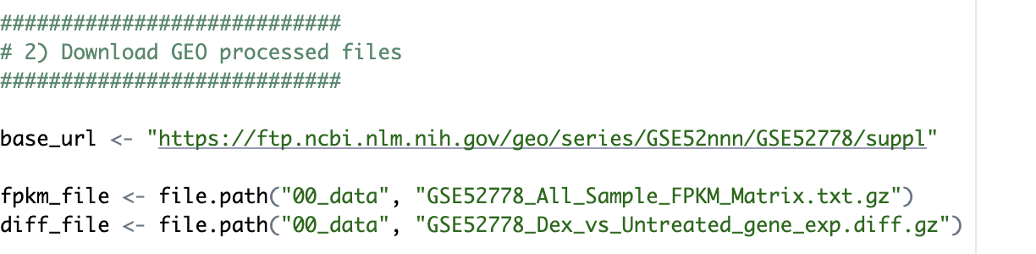
Download and Processed GEO FPKM matrix + .diff file
There is a brief materials and methods on the authors conduct DE analysis
We need to search to find processed package in the old version NCBI website
There is also no documentation on script

Slide 18
DE workflow
1. Download and Processed GEO FPKM matrix + .diff file
2. Inspect the files
3. Clean differential-expression table
5. Top differentially expressed genes
[table 1 replication]
4. DE result visualization
[volcano plot replication]

Slide 19
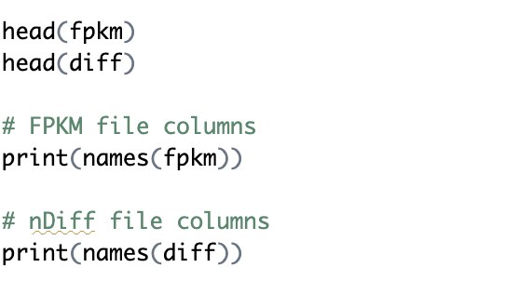
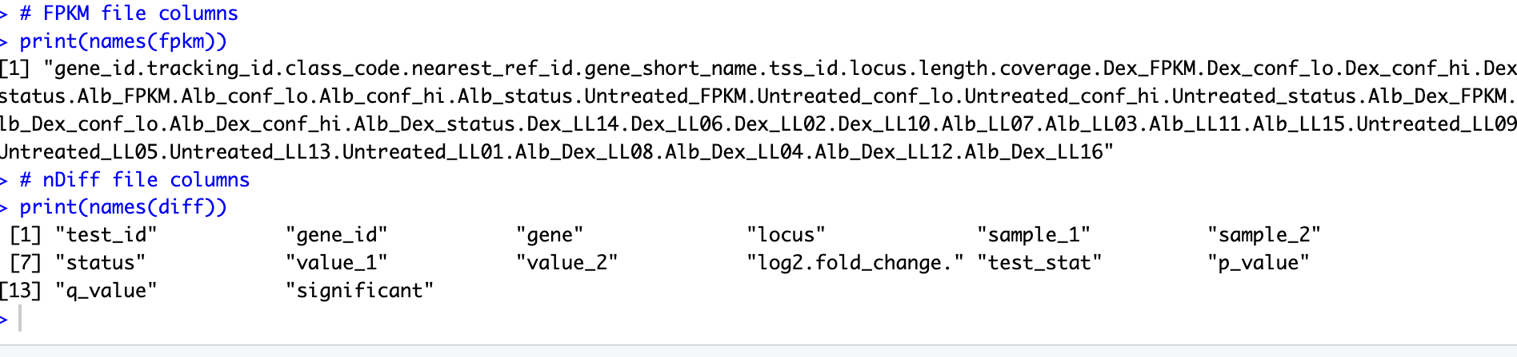
Inspection and clean the files
Use ’head(X)’ and ‘print(names(X))’ to inspect the files
Now we know that the processed files contain the statistic value and log2fold change -> we now can recreate the figures/tables

Slide 20
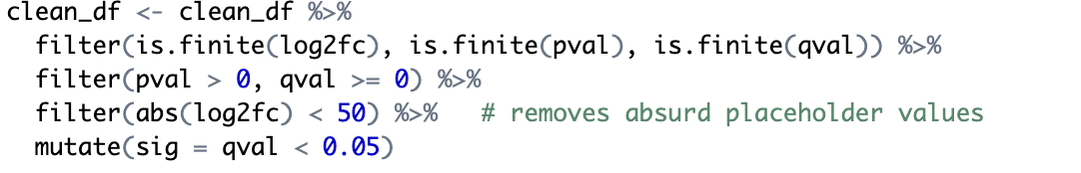
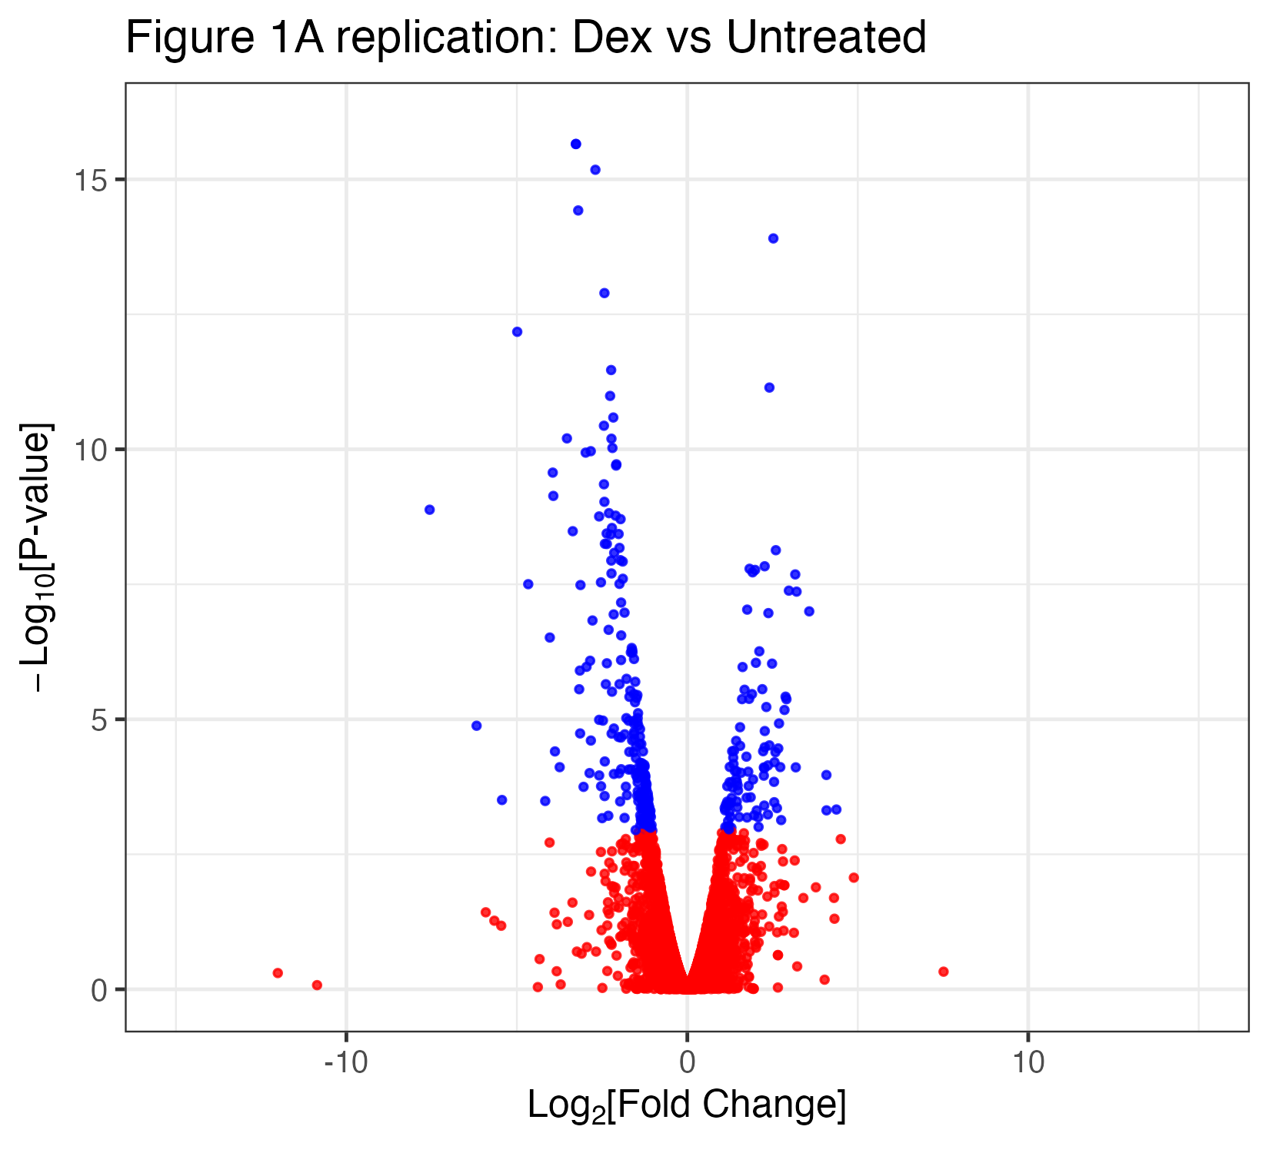
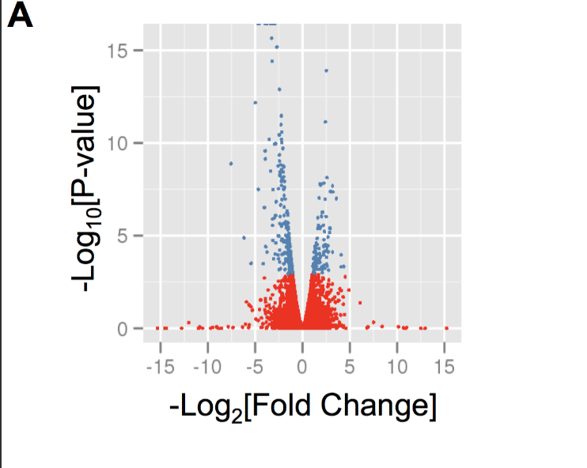
Result comparison: volcano plot
We removes extreme placeholder log2 fold-change values
Actual journal
Our result
log2 fold change = log2(expression in Dex / expression in Control)
Notes:
Explain the graph……..
We removed some extreme value that is not biologically possible and not sure what happen with the actual paper result but most of the expression is capture so we wonder if the top expressional gene are different

Slide 21
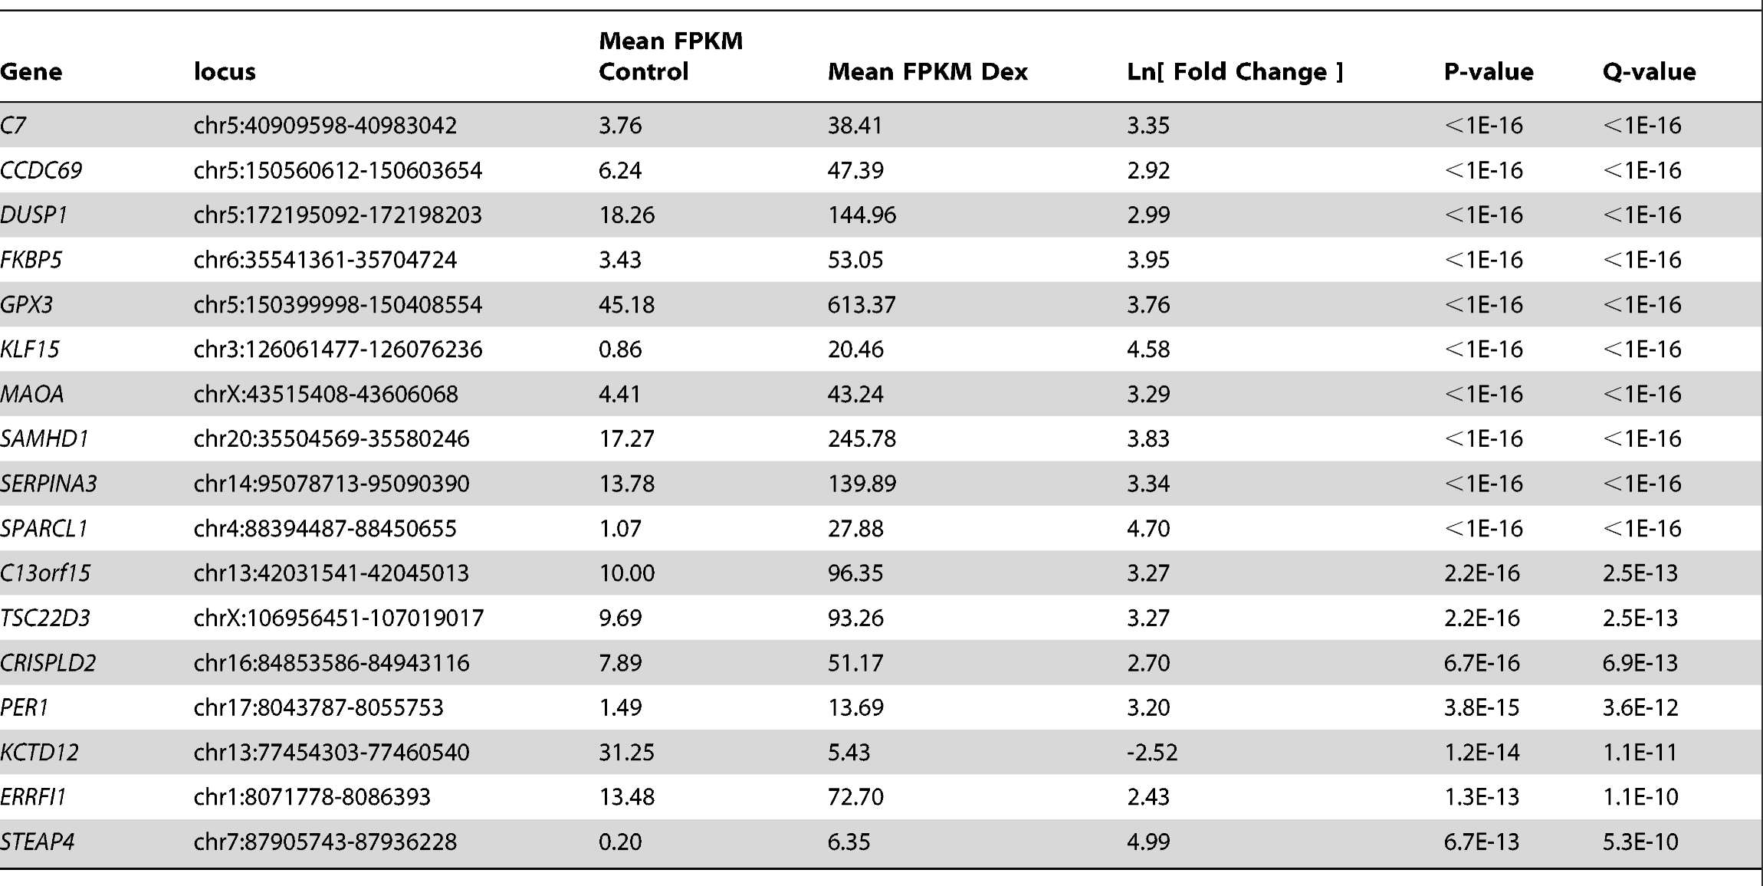
Result comparison: Top differential expression genes
In R = 0
top genes with Q-value < 1E-10
Notes:
Explain the table…

Slide 22
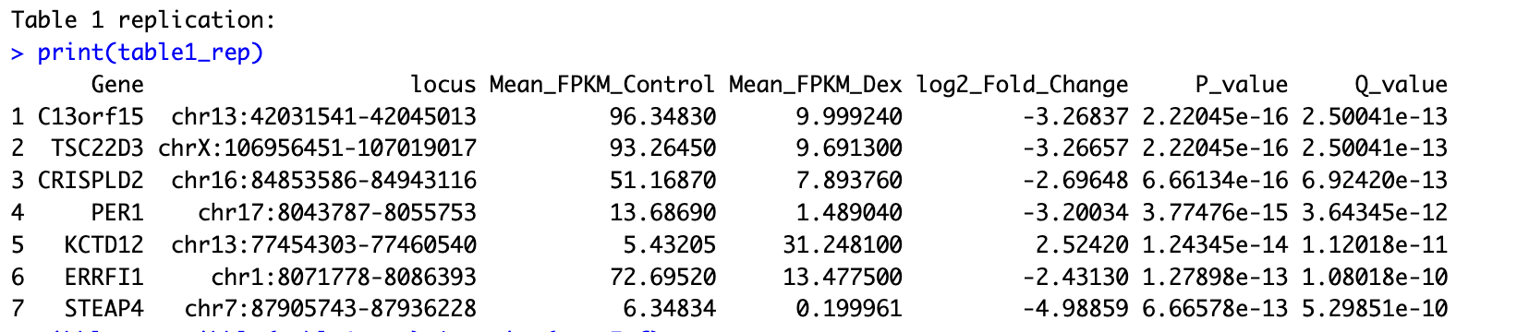
Result comparison: Top differential expression genes
top genes with Q-value < 6E-10
Notes:
I think because we clean a data and that might potential mean a smaller finding of top genes. However CRISPLD2 were included in the result, which replicate the conclusion of the paper. However, we should go identify where did the process cause a different in the teo results. Since there is no documentation on pipeline of the analysis. It is hard to tell which part that we do go differentky than the original data.

Slide 23
RNA-seq differential expression workflow
1. Install and load analysis packages/ load a dataset
2. Inspect the data/metadata
3. Build the DESeq2 analysis object
e.g. BiocManager, airway, DESeq2, SummarizedExperiment, ggplot2
assay(se), colSums(assay(se)), colData(se), rowRanges(se)
dds <- DESeqDataSet(se, design = ~ cell + dex)
dds$dex <- relevel(dds$dex, ref = "untrt")
7. Run differential expression analysis
5. Exploratory sample-level QC
4. Variance-stabilizing transformation for visualization
Sample distance plot
sampleDists <- dist(t(assay(rld)))
sampleDistMatrix <- as.matrix(sampleDists)
hc <- hclust(sampleDists)
PCA plot: plotPCA(rld, intgroup = c("dex", "cell"))
rlog(dds), estimateSizeFactors(dds)
dds <- DESeq(dds)
res <- results(dds, contrast = c("dex", "trt", "untrt"))
Notes:
The document that create this pipeline is quite well written. It is more like a tutorial so we are able to replicate 100% of the same result of the plots or DE analysis. The only problem is that the data package only work with some analysis package so we need to work around for this to work. We will focus on this 7 steps, we will explain why it needed for each step before running DE analysis and show a picture of our result in the end. And here is the commands or package use in the different step…..

Slide 24
RNA-seq differential expression workflow
1. Install and load analysis packages/ load a dataset
2. Inspect the data/metadata
3. Build the DESeq2 analysis object
This is the first quality check Before running any model
7. Run differential expression analysis
5. Exploratory sample-level QC
4. Variance-stabilizing transformation
This is the main statistical analysis step by DEseq2
Sample distance heatmap and PCA plots
Without normalization, some samples may look like it has higher expression only because it had more reads.
Notes:
Now we will go through each steps why it is important before we do RNAseq
2. inspect/metadata
This is the first quality check. Before running any model, we need to confirm that the data are correctly structured.
RNA-seq analysis depends on correctly matching the count matrix with sample metadata. If sample labels are wrong, the whole differential expression result becomes unreliable.
3. Builf the DE seq
DESeq2 needs a specific object called a DESeqDataSet. This object connects:
raw counts + sample metadata + statistical design
In order to run analysis
4. Variance-stabilizing transformation for visualization
RNA-seq samples often have different sequencing depths. For example:
Sample A: 20 million reads Sample B: 35 million reads
Without normalization, Sample B may look like it has higher expression only because it had more reads.
Size-factor normalization corrects this technical difference.
Why we use rlog
RNA-seq count data are noisy, especially for low-count genes. The rlog() transformation stabilizes the variance so the data are better suited for visualization
5. QC
This step includes the sample distance heatmap and PCA plots.
The sample distance heatmap shows how similar or different samples are from each other based on their overall gene expression profiles.
PCA shows the largest sources of variation across all samples.
We do QC before differential expression analysis because RNA-seq results are only meaningful if the samples and data structure are reliable.
In this workflow, QC mainly checks whether the samples behave as expected before trusting the DESeq2 results.
7. DEseq2 analysis
This is the main statistical analysis step.
DESeq() fits a negative binomial model for each gene. It estimates:
normalization factors
dispersion
log2 fold change
test statistic
p-value
adjusted p-value
Why negative binomial?
RNA-seq data are count data and usually have more variability than a simple Poisson model assumes. The negative binomial model accounts for this extra biological variability.
This step give life to
Top gene count plot
MA plot
Dispersion plot

Slide 25
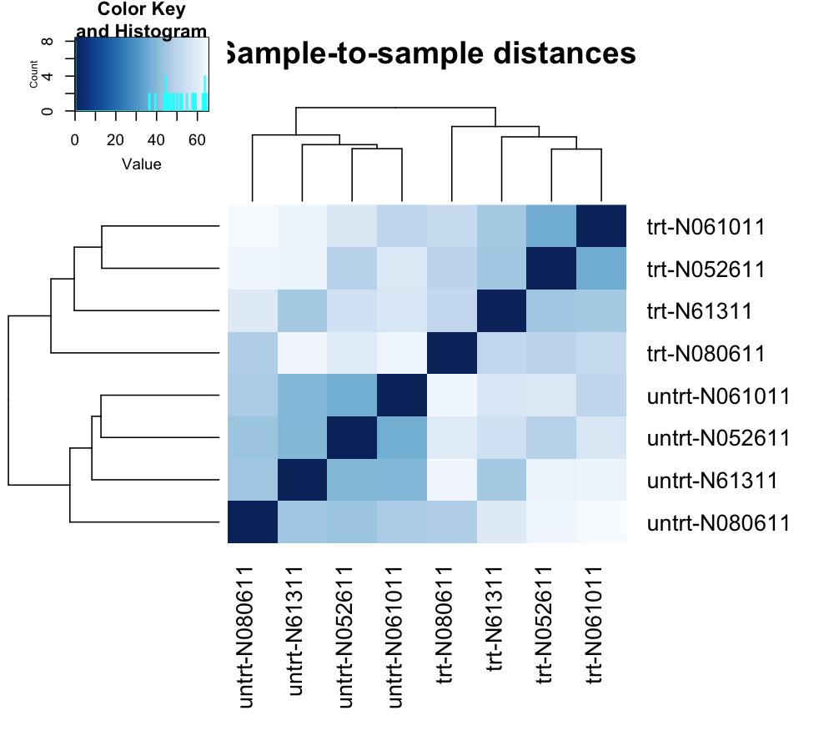
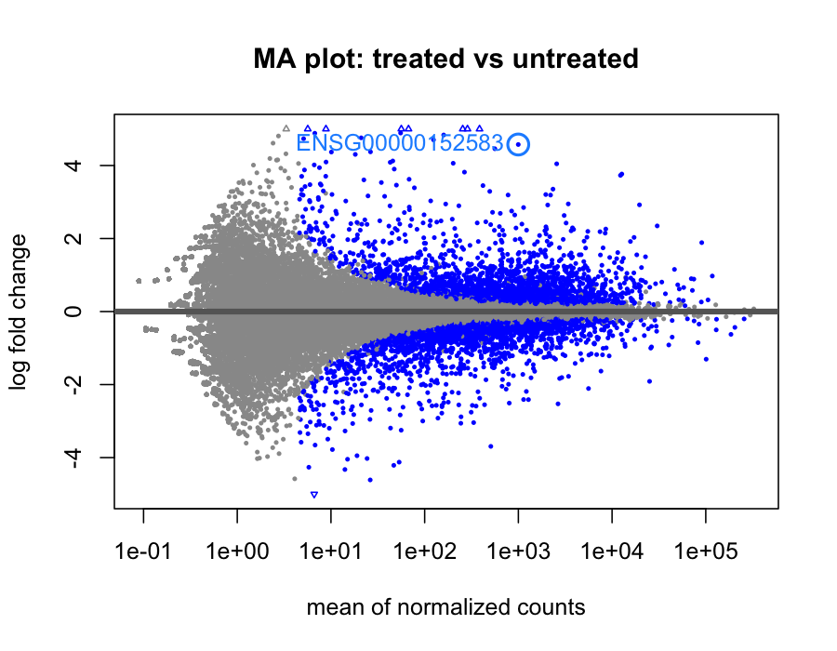
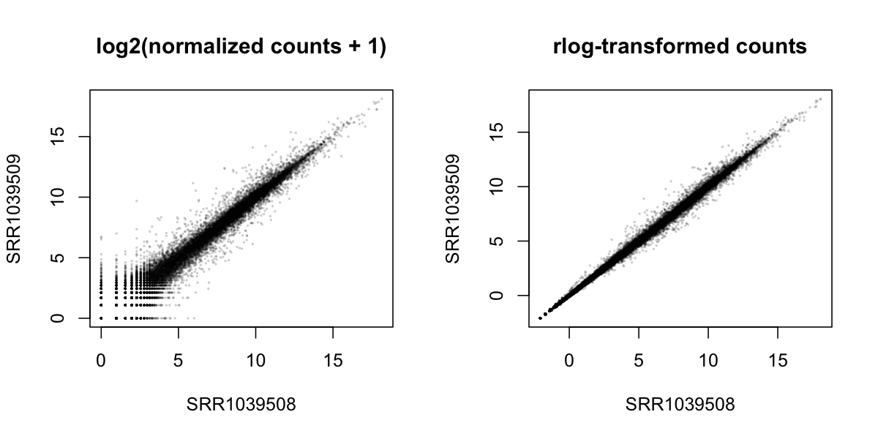
RNA-seq differential expression workflow: Results
1. Install and load analysis packages/ load a dataset
2. Inspect the data/metadata
3. Build the DESeq2 analysis object
This is the first quality check Before running any model
7. Run differential expression analysis
5. Exploratory sample-level QC
4. Variance-stabilizing transformation
This is the main statistical analysis step by DEseq2
Sample distance heatmap and PCA plots
Without normalization, some samples may look like it has higher expression only because it had more reads.
Notes:
Since we successfully recreate all the plots, and we will not have time to go through each of them. here are the examples of the plot created by this steps
Have animation… to show plot

Slide 26
Conclusion
Biological answer to this journal
Using RNA-seq, the study identified 316 differentially expressed genes after dexamethasone treatment.
Among these genes, CRISPLD2 was prioritized as a candidate regulator of inflammatory responses.
What we learned
We are interested in this project since there is no documentation on actual journal page and we want to learn how to use DESeq2
Learn about which data should be used for DESeq2 and how to analyze differential gene expression
The actual pipeline/scripts can be hard to replicate if it is not document properly [The different results we got]
Remind us to think about the version change of some certain long term storage website [NCBI]
The created package in R or some analysis package in R are sometimes not up to date [how we should be careful if we use and create one]

Slide 27
Thank you for your attention!

Slide 28
References
Himes BE, Jiang X, Wagner P, Hu R, Wang Q, Klanderman B, Whitaker RM, Duan Q, Lasky-Su J, Nikolos C, Jester W, Johnson M, Panettieri R Jr, Tantisira KG, Weiss ST, Lu Q. “RNA-Seq Transcriptome Profiling Identifies CRISPLD2 as a Glucocorticoid Responsive Gene that Modulates Cytokine Function in Airway Smooth Muscle Cells.” PLoS One. 2014 Jun 13;9(6):e99625. PMID: 24926665. GEO: GSE52778.
Morgan (2015). https://www.bioconductor.org/help/course-materials/2015/Uruguay2015/V6-RNASeq.html#background

Slide 29
Install and load analysis packages and load a prepared RNA-seq dataset
Install and load analysis packages Programs/packages used: BiocManager, airway, DESeq2, org.Hs.eg.db, AnnotationDbi, SummarizedExperiment, gplots, RColorBrewer, ggplot2
airway: example RNA-seq dataset
DESeq2: differential expression analysis
org.Hs.eg.db, AnnotationDbi: gene ID annotation
SummarizedExperiment: container for counts + metadata + ranges
gplots, RColorBrewer: heatmap
ggplot2: PCA and count plots
Load a prepared RNA-seq dataset Information used: airway dataset stored as a SummarizedExperiment object called se What is already inside this object se:
raw count matrix
sample metadata
genomic ranges

Slide 30
Inspect the data and build the DESeq2 analysis object
Inspect the data Functions used: assay(se), colSums(assay(se)), colData(se), rowRanges(se) Information used:
gene-by-sample count matrix
total counts per sample
metadata such as treatment and cell line
genomic coordinates of features Purpose: basic data inspection before modeling.
Build the DESeq2 analysis object Program/package used: DESeq2 Function used: DESeqDataSet(se, design = ~ cell + dex) Information used:
counts from se
metadata variables cell and dex Purpose: create the model structure, controlling for cell line and testing treatment effect.

Slide 31
Variance-stabilizing transformation for visualization and Exploratory sample-level QC
Variance-stabilizing transformation for visualization Program/package used: DESeq2 Functions used: rlog(dds), estimateSizeFactors(dds) Information used: raw counts Purpose: transform counts so PCA and clustering are more stable and interpretable. This is for visualization, not the main statistical test.
Exploratory sample-level QC Programs/packages used: DESeq2, gplots, RColorBrewer, ggplot2 Functions used:
dist(t(assay(rld))) for sample distances
hclust() for clustering
heatmap.2() for distance heatmap
plotPCA() and ggplot() for PCA Information used: rlog-transformed expression values and sample metadata (dex, cell) Purpose: check whether samples cluster by treatment or cell line, and identify possible outliers

Slide 32
Run differential expression analysis
Run differential expression analysis Program/package used: DESeq2 Functions used: DESeq(dds), results(dds) Information used:
count matrix
design formula ~ cell + dex
treatment labels Purpose: estimate size factors, dispersions, fit the negative binomial model, and test for differential expression.

